Slide 1
Containers and Docker Concepts
1

Slide 2
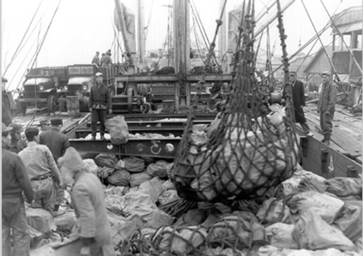
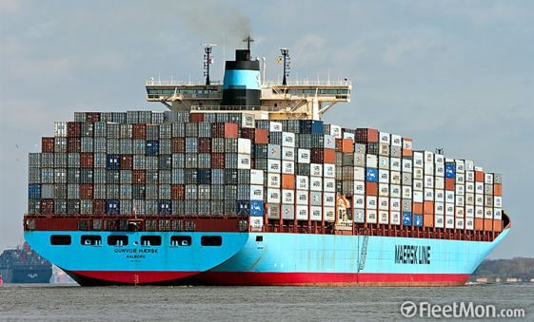
Everybody loves containers

Slide 3
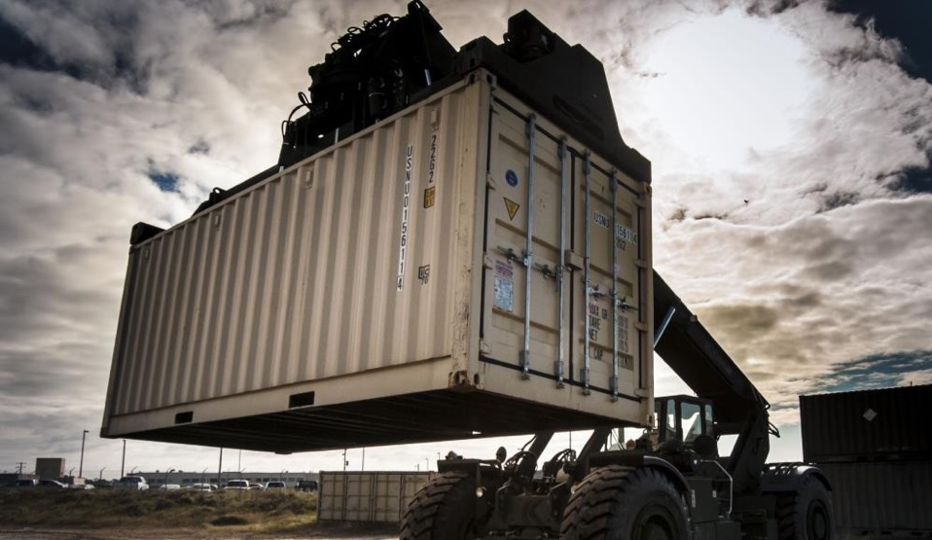
Containers
A standard way to package an application and all its dependencies so that it can be moved between environments and run without changes.
Containers work by isolating the differences between applications inside the container so that everything outside the container can be standardized.
IBM Bluemix Container Service | IBM Confidential | ©2017 IBM Corporation

Slide 4
VMs vs Containers
_{App}
_{A}
_{App}
_{A}
_{App}
_{B}
_{bins/}
_{libs}
_{bins/}
_{libs}
_{bins/}
_{libs}
Containers are isolated, but share OS and, where appropriate, bins/libraries
_{VM}
_{Guest}
_{OS}
_{Guest}
_{OS}
_{Guest}
_{OS}
_{Guest}
_{OS}
_{Guest}
_{OS}
_{Guest}
_{OS}
App A
App A
App A
App B
App B
App B
App B
Container
_{Hypervisor (Type 2)}
bins/libs
bins/libs
_{Host OS}
Host OS
_{Server}
Server

Slide 5
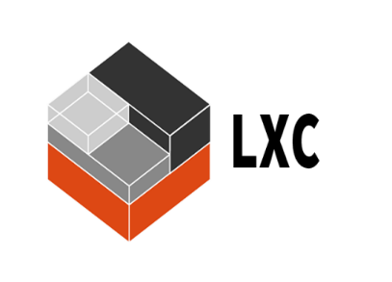
Containers
A standard way to package an application and all its dependencies so that it can be moved between environments and run without change.
Containers work by hiding the differences between applications inside the container so that everything outside the container can be standardized
Docker: Created standard way to create images for Linux Containers
Linux Containers (LXC) details:
An isolated user space within a running Linux OS
Shared kernel across containers
Direct device access
All packages and data in an isolated runtime, saved as a filesystem
Resource management implemented with control groups (cgroups)
Resource isolation through namespaces

Slide 6


The challenge
Static website
Nginx
Openssl
Bootstrap 2
modsecurity
User DB
Postgresql
pgv8
v8
Web frontend
Ruby
Rails
Sass
Unicom
Queue
Redis
Redis-sentinel
Analytics DB
Hadoop
Hive
Thrift
OpenJDK
Do services and apps interact appropriately?
Multiplicity of Stacks
Can I migrate smoothly and quickly
Multiplicity of hardware environments
Development
VM
QA server
Customer Data Center
Production Cluster
Contributor’s laptop
Public Cloud
Notes:
All this stuff you need to deploy
All these ways to deploy it

Slide 7
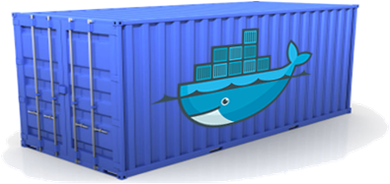
A shipping container for code
Static website
User DB
Web frontend
Queue
Analytics DB
Do services and apps interact appropriately?
Multiplicity of Stacks
An engine that enables any payload to be encapsulated as a lightweight, portable, self-sufficient container…
…that can be manipulated using standard operations and run consistently on virtually any hardware platform
Can I migrate smoothly and quickly
Multiplicity of hardware environments
Development
VM
QA server
Customer Data Center
Production Cluster
Contributor’s laptop
Public Cloud
Notes:
All this stuff you need to deploy
All these ways to deploy it

Slide 8

Dev vs. Ops
Dev | Ops
Code Libraries Configuration Server runtime OS | Logging Remote access Network configuration Monitoring
Separation of concerns
A container separates and bridges the Dev and Ops in DevOps
Dev focuses on the application environment
Ops focuses on the deployment environment

Slide 9


Container history lesson
1982
2000
2005
2006
2007
2008
Today
Unix/chroot
BSD
OpenVZ
Parallels
AIX Wpars
IBM
FreeBSD jails/Solaris zones
Cgroups/Process Containers
IBM/Google
LXC

Slide 10

Introduction to Docker
Enabling application development efficiency, making deployment more efficient, eliminating vendor ‘lock-in’ with true portability
Open Software
Launched March 2013
2.0+ billion downloads of Docker images
Open Contribution
2000+ contributors
#2 most popular project
185 community meet-up groups in 58 countries
Open Design
Contributors include IBM, Red Hat, Google, Microsoft, VMware, AWS, Rackspace, and others
Open Governance
12 member governance advisory board selected by the community

Slide 11

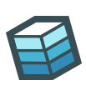
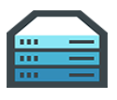













Docker mission
Docker is an open platform for building distributed applications for developers and system administrators.
Build
Ship
Run
Any App
Anywhere

Slide 12

Docker basics – A shipping container for code
Image
A read-only snapshot of a container stored in Docker Hub to be used as a template for building containers
Container
The standard unit in which the application service resides or transported
Docker Hub/Registry
Available in SaaS or Enterprise to deploy anywhere you choose
Stores, distributes and shares container images
Docker Engine
A program that creates, ships and runs application containers
Runs on any physical and virtual machine or server locally, in private or public cloud
Client communicates with Engine to execute commands
SaaS
Enterprise

Slide 13
Docker containers
Shared and layered file systems technology
Docker uses a copy-on-write (union) file system. New files and edits are only visible to current and above layers.
Container 1
Container 2
Container 3
Container 4
Layer
app1
app2
app3
app4
Layer
tomcat
liberty
tomcat
Layer
Fedora
Ubuntu
Base OS / Kernel
Filesystem
Layers allow for reuse:
More containers per host
Faster start-up/download time – base layers are "cached"
Each layer is a tarball. An image is a tarball of layers.
Notes:
A container consists of an operating system, user-added files, and meta-data. As we've seen, each container is built from an image. That image tells Docker what the container holds, what process to run when the container is launched, and a variety of other configuration data. The Docker image is read-only. When Docker runs a container from an image, it adds a read-write layer on top of the image (using a union file system as we saw earlier) in which your application can then run.

Slide 14
Why all the interest in containers?
Containers are a critical foundation for distributed apps in Hybrid Clouds
Ship more software
Accelerate development, CI and CD pipelines by eliminating headaches of setting up environments and dealing with differences between environments. On average, Docker users ship software more frequently.
Resource efficiency
Lightweight containers run on a single machine and share the same OS kernel while images are layered file systems sharing common files to make efficient use of RAM and disk and start instantly.
App portability
Isolated containers package the application, dependencies and configurations together. These containers can then seamlessly move across environments and infrastructures.

Slide 15


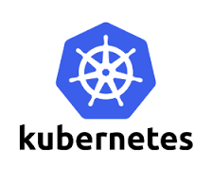

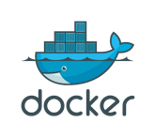


More to containers than just Docker
Serverless
PaaS
Container orchestration
Container engine

